Slide 1
Famous Journals in Our Field
Brian Image & Neuroscience
Pro Liang
Li Siyang

Slide 2
01
Part ONE
PNAS
Identify brain regions scopolamine induce intensity changes
Evaluate the effects of scopolamine on FC
Whether scopolamine-induced memory effect could be
reversed with milameline

Slide 3
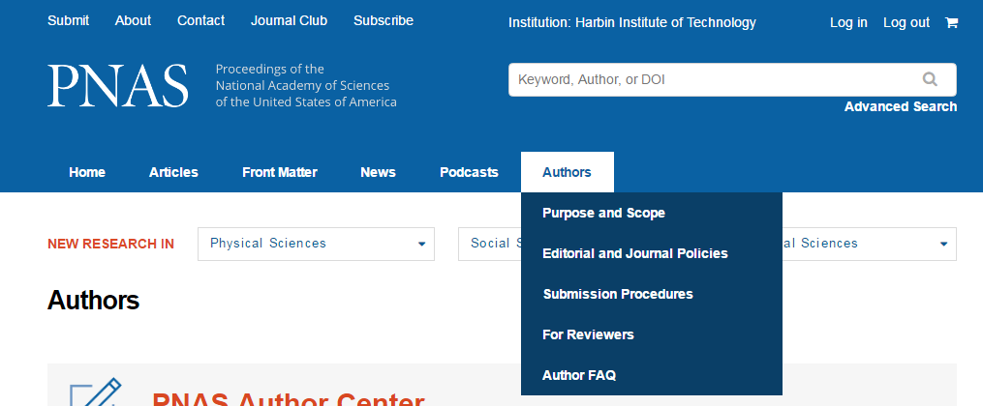
Conclusions
Synaptic Physiology:
left-dominance of NR2B density
right-dominance of GluR1 density
left-dominance at Schaffer collateral synapses

Slide 4
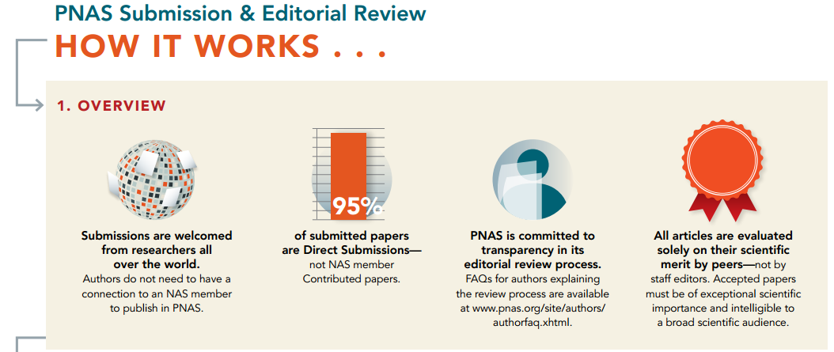
Conclusions
Synaptic Physiology:
left-dominance of NR2B density
right-dominance of GluR1 density
left-dominance at Schaffer collateral synapses

Slide 5
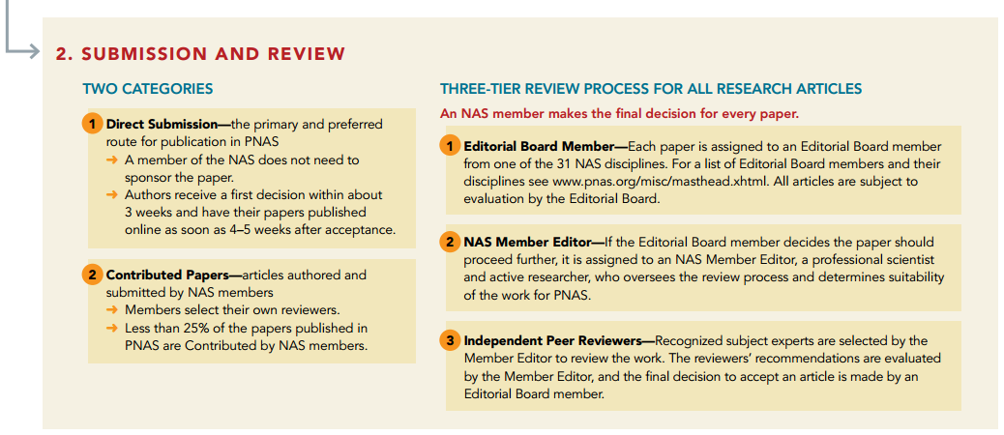
Conclusions
Synaptic Physiology:
left-dominance of NR2B density
right-dominance of GluR1 density
left-dominance at Schaffer collateral synapses

Slide 6
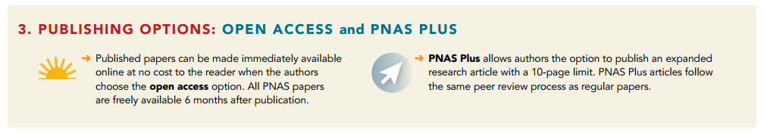
Conclusions
Journal\PNAS.pdf

Slide 7
02
Part TWO
Cerebral Cortex
Identify brain regions scopolamine induce intensity changes
Evaluate the effects of scopolamine on FC
Whether scopolamine-induced memory effect could be
reversed with milameline

Slide 8
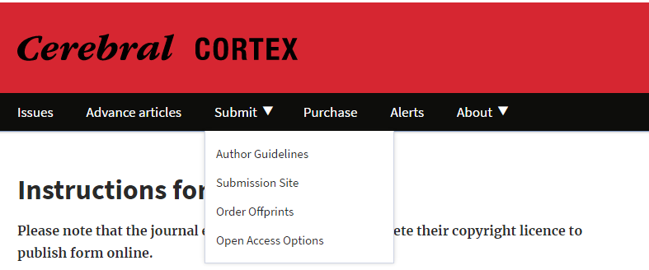
Optogenetics
Journal\CC About the Journal.docx
Journal\CC S1.docx
AAV5-CaMKIIα-eNpHR3.0-eYFP
Green light
Reversible silencing of spontaneous spiking
One-sample t tests

Slide 9
03
Part THREE
The Journal of
Neuroscience
Identify brain regions scopolamine induce intensity changes
Evaluate the effects of scopolamine on FC
Whether scopolamine-induced memory effect could be
reversed with milameline

Slide 10
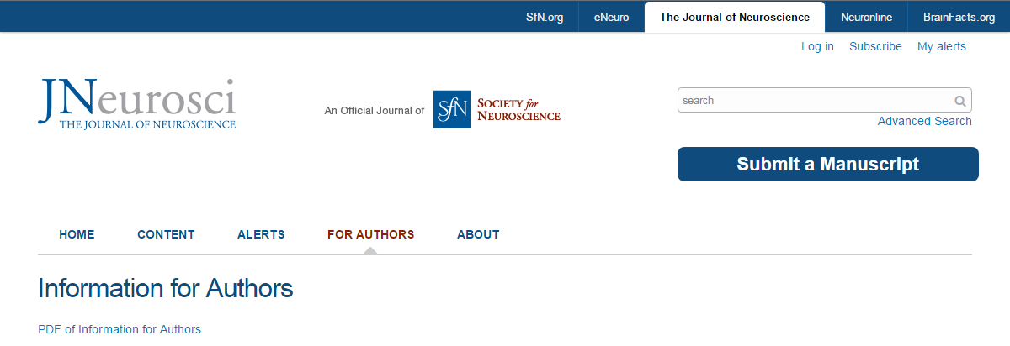
Journal\JN_Information_for_Authors.pdf

Slide 11
Something about RSS

Slide 12
My 1st way to track advances in the fields I interested in:
Email Alert:
Let them to send alerts to your email directly

Slide 13
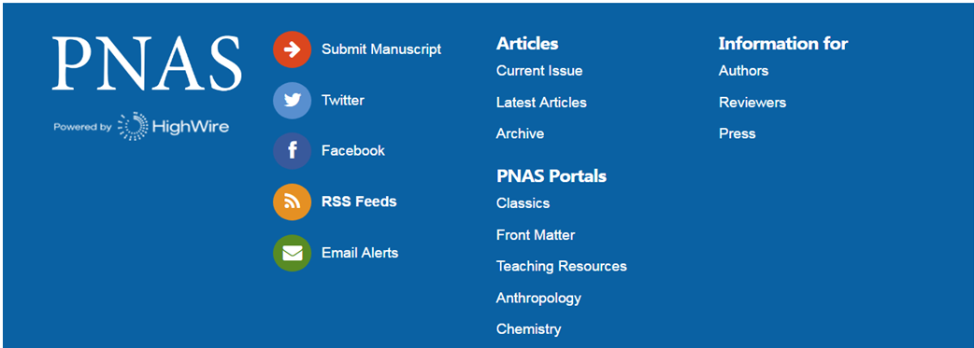

Slide 14
My 2nd ways to track advances in the fields I interested in:
RSS link(If you don’t)

Slide 16
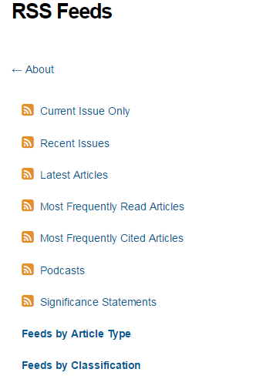
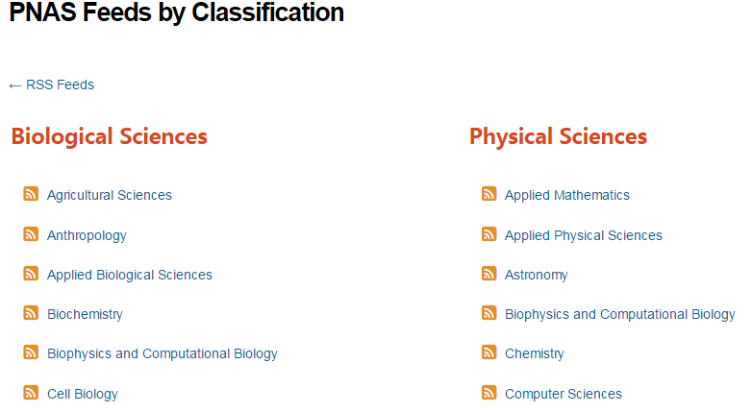

Slide 17
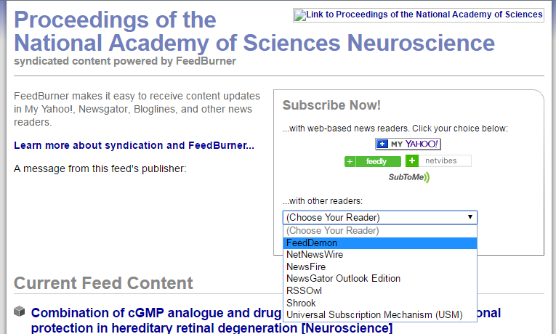

Slide 18
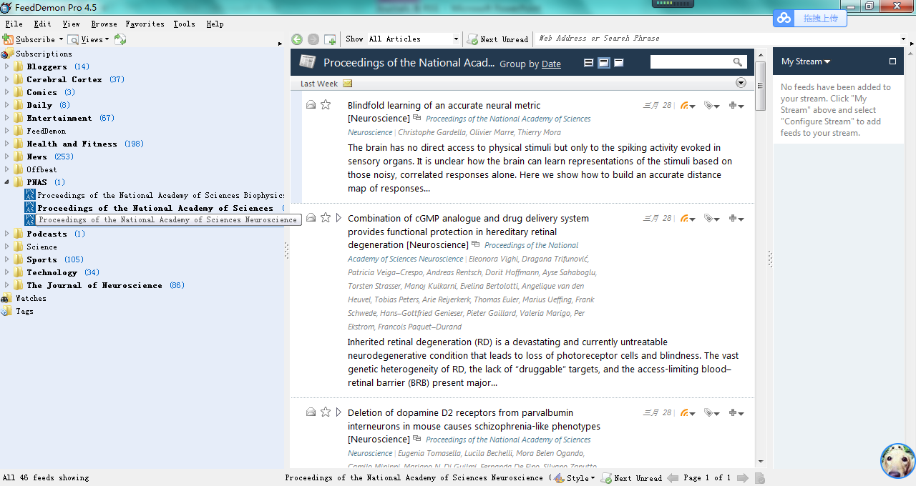

Slide 19
My 3rd ways to track advances in the fields I interested in:
RSS link(If you have a kindle)

Slide 22


Slide 23
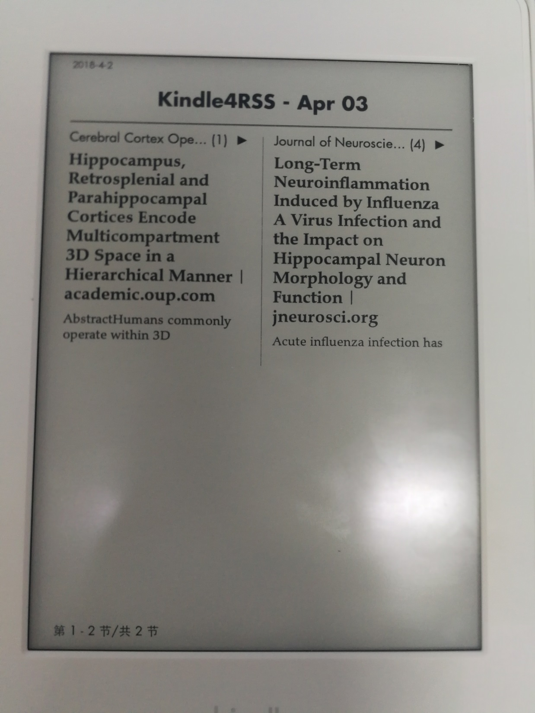

Slide 24
Thank you all for listening~

